Slide 1
Education and Healthcare Spending
Kyi Win
March 12, 2018

Slide 2
Overview
Source of the dataset
About dataset
Exploration of Education and Healthcare Spending
Comparing with the country’s GDP
Comparing with overall military spending of the country
Comparing per person educational spending to per person GDP
Comparing per person healthcare spending to per person GDP
Fastest growing countries in healthcare and education spending
Conclusion

Slide 3
Source of the data
The data comes from the multiple sources.
Data related to Military spending such as military spending in US$, military expenditure in GDP%, and per person GDP are obtained from Stockholm International Peace Research Institute (SIPRI) Military Expenditure database.
Education and Healthcare spending raw datasets are from World Bank database.
Other datasets such as annual growth rate, overall military spending and etc. are calculated using existing datasets with python and data frames were extracted as excel from the jupyter.

Slide 4
About dataset
Extracted data frame for Educational spending includes 13 countries which are one of the countries that spent the most on education.
Extracted data frame for Healthcare spending includes 20 countries with highest GDP.
Both Educational and healthcare data frame are from 2006 to 2014 (9 years).
Military spending of the same countries data frame are extracted from the datasets.

Slide 5
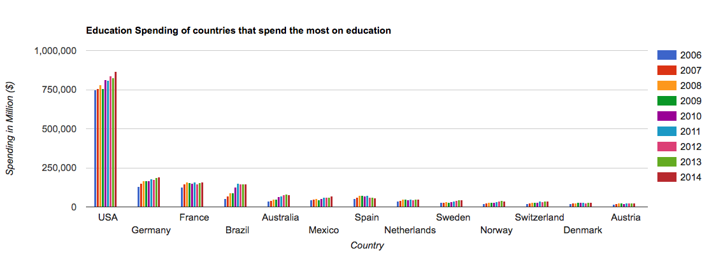
Exploration of Education and Healthcare datasets
The United States spent the most on education and the education spending of united states was increasing in 9 years of 2006 to 2014.
Notes:
United States is the country that spends the most on education spending compared to the other 12 countries which spend the most on education , and from 2006 to 2014, the growth is pretty steady. Germany take the second place in education spending then France.

Slide 6
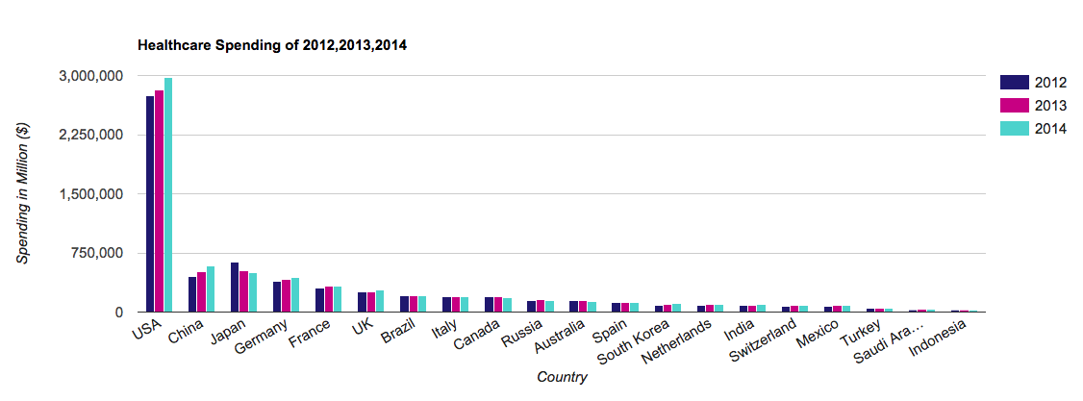
Exploration of Education and Healthcare datasets
During the three years of 2012 to 2014, United States spent the most in healthcare. China takes the second place.
Notes:
In 3 years of 2012 to 2014, United states also spends the most in healthcare, china take the second place in healthcare spending.

Slide 7
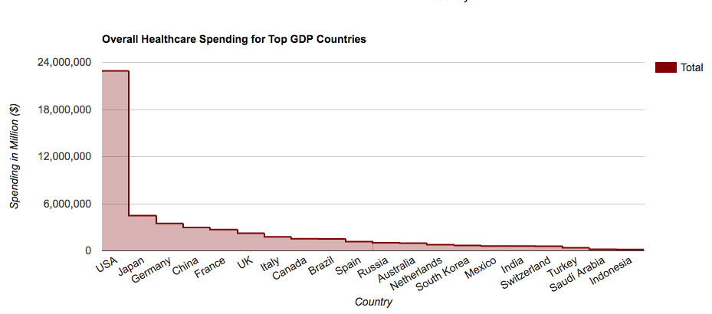
Exploration of Education and Healthcare datasets
Notes:
However, comparing 9 years total from 2006 to 2014, Japan and Germany take 2nd and 3rd place in healthcare spending total, which is then followed by china. Turkey, Saudi arabia, and indonesia spent the least in both 3 years period and overall 9 years period.

Slide 8
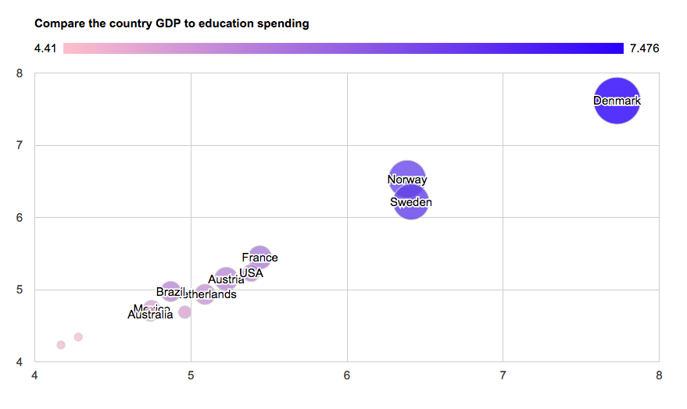
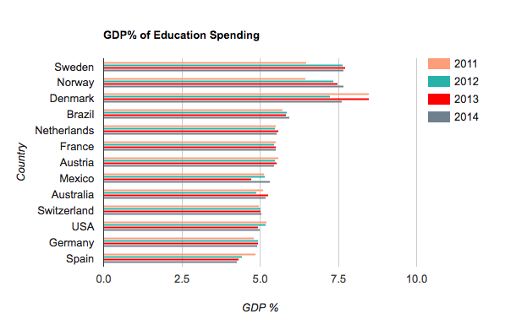
Comparing with the country’s GDP
Notes:
Denmark, Norway and Sweden spent the most in education spending compared to their percent GDP. The United States spends around 5% of the total GDP on education.

Slide 9
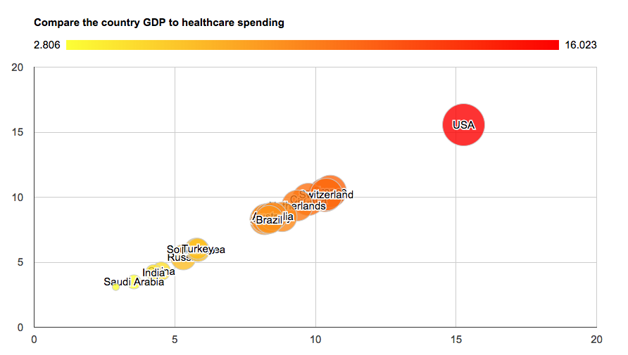
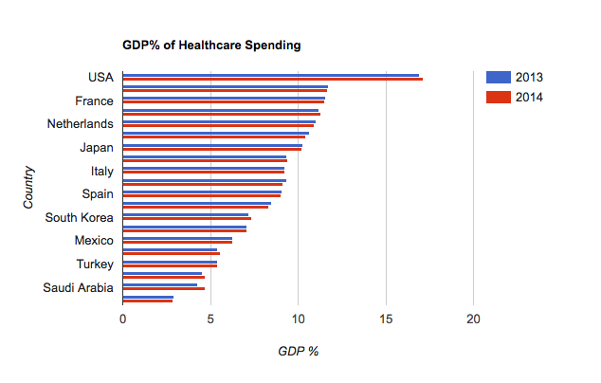
Comparing with the country’s GDP
Notes:
Compared to the country’s GDP, the United States spent the most on healthcare followed by France, switzerland and canada. We can see that US spends triple on Healthcare than it does on Education.

Slide 10
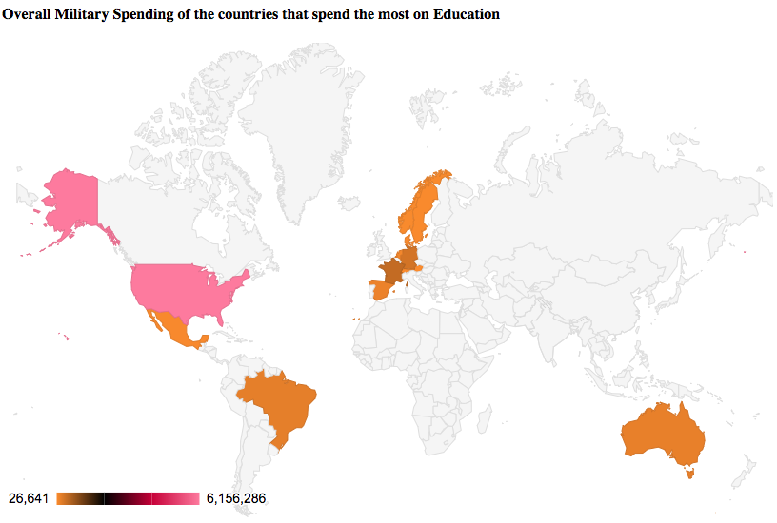
Comparing with overall military spending of the country
Notes:
Compared to the overall military spending United States spends the most on military as it does in health care and education. Denmark, which spend the most on education compared to their GDP, spends around 25000 Million on their military spending

Slide 11
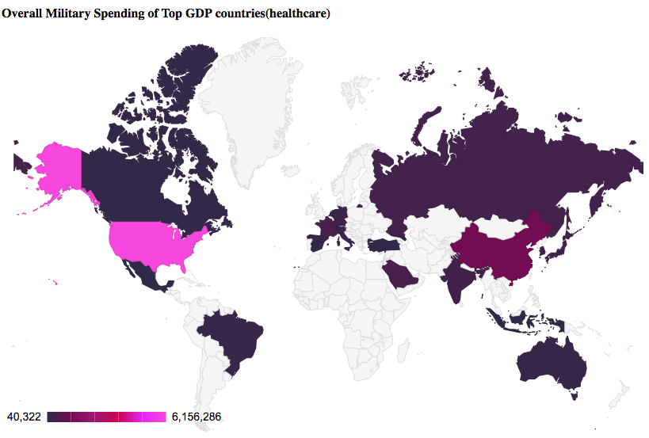
Comparing with overall military spending of the country
Notes:
US, China, Saudi Arabia and France, then Russia
Healthcare- us, france, switzerland and canada

Slide 12
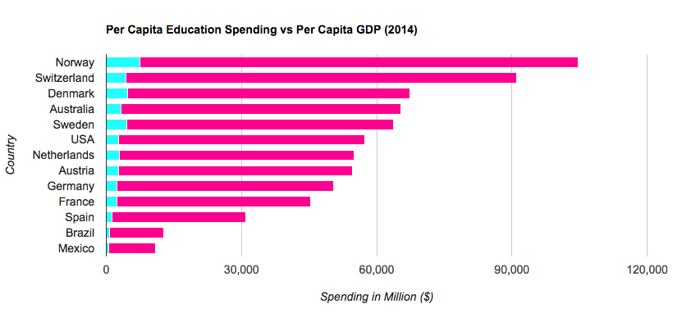
Compare per person education spending to per person GDP
Notes:
People in norway has the most per person GDP and they spends the most on per person education spending
Switzerland spends less in per person gdp even through they have higher per person GDP than people in Denmark.
Denmark which spend highest % of their gdp on education has less per person gdp than switzerland and norway.

Slide 13
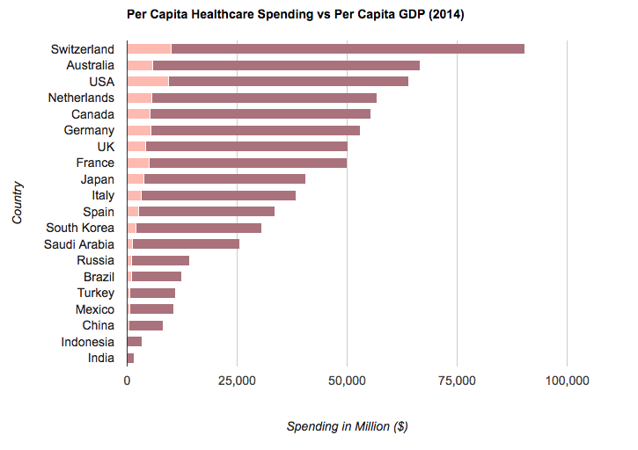
Compare per person healthcare spending to per person GDP
Notes:
Switzerland spends the most on healthcare per capita compared to per person GDP. US spends similar amount on healthcare per person even though it amount on per person GDP is a lot lower than switzerland.

Slide 14
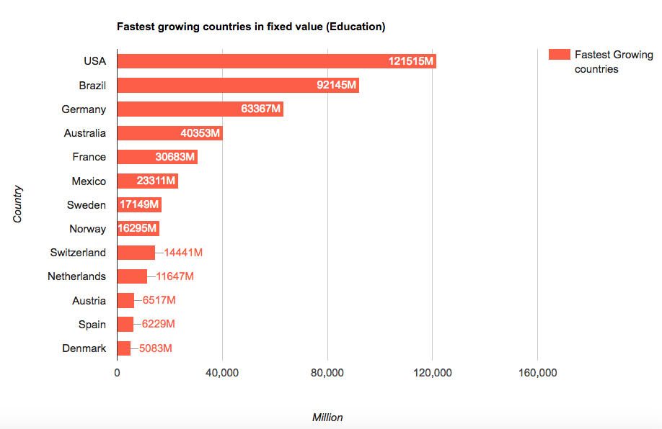
Fastest growing countries in Education and Healthcare
Notes:
We can see that US is the fastest growing countries in Education. And Brazil is taking the second place. Even through Denmark spend the most on education compared to their GDP, it is not fastest growing countries in Education.

Slide 15
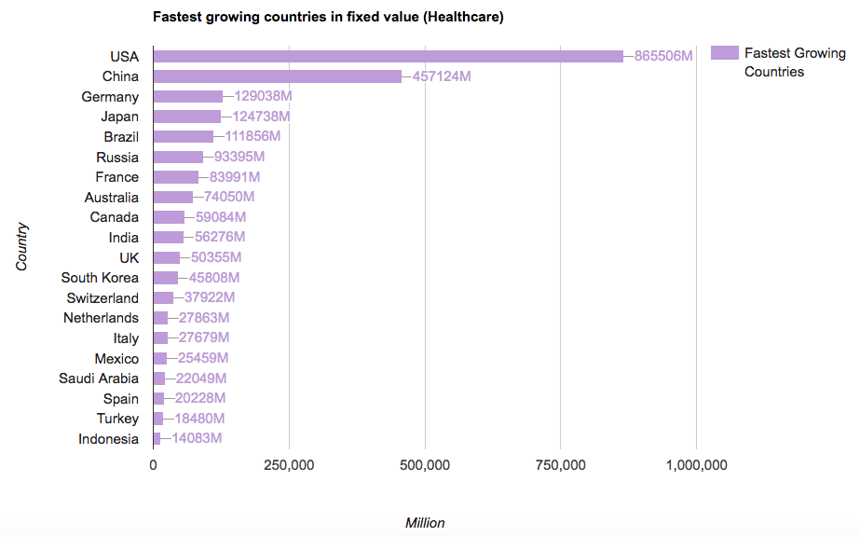
Fastest growing countries in Education and Healthcare
Notes:
USA is fastest growing country in healthcare expenses. China is the 2nd on fastest growing country even though it spend overall spending of 2006 to 2014 is less than Japan and Germany.

Slide 16
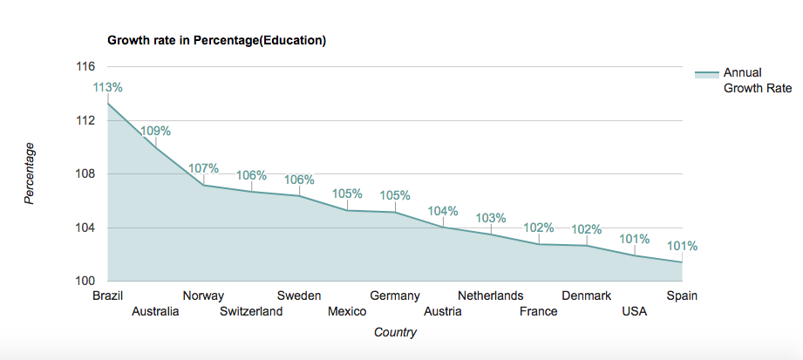
Fastest growing countries in Education and Healthcare
Notes:
Annual growth rate on education of the country shows that Brazil is the country with highest growth rate, and spain has lowest growth rate on Education.

Slide 17
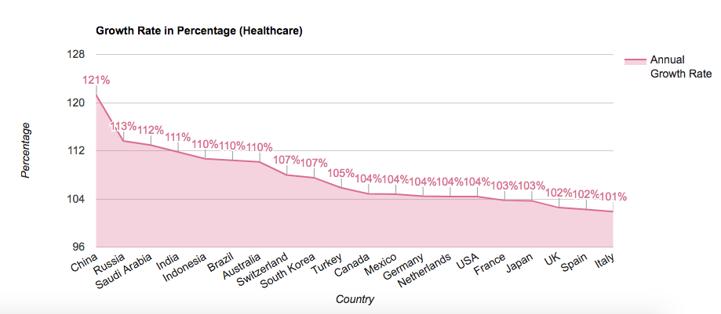
Fastest growing countries in Education and Healthcare
Notes:
China is country with highest annual growth rate on healthcare. We can see that Australia and switzerland has high growth rate on both education and healthcare.

Slide 18
Conclusion
US spent the most on healthcare and education expenses from 2006 to 2014.
Compared to the GDP of the country, Denmark spent highest % on education and USA spent highest % on healthcare.
Compared with overall military spending, US spent the most on military spending as it does on both education and healthcare. Denmark spent less on military spending although it spent highest% on education compared to country’s GDP. While France, Switzerland and Canada spent highest % on healthcare compared to country’s GDP, China, Saudi Arabia and Russia spent on the military spending.
Norway has highest per person GDP and highest per person in education spending. Mexico has the lowest.
Switzerland has highest per person GDP and highest per person in healthcare spending compared to other top GDP countries. India has the lowest in healthcare spending compared to other top GDP countries.
USA is the fastest growing country in both healthcare and education. While Denmark spend highest % of their GDP in education compared to the country’s GDP, it is the lowest in growing compared to other 12 countries which spent the most on Education.
Brazil is found to have the highest annual growth rate compared to other 12 countries which spent the most on Education and China is found to have the highest annual growth rate in healthcare out of top GDP countries.

